Slide 1
Missing Links The application that will help you find the missing pieces in your life!
Created by The Missing Links: Maria Doyle, Mary Miller, Derreyl Anderson, Charles Jude Presita

Slide 2
About Us
We are all students in the July 2016 Cohort of the UNC Coding Boot Camp
Some technical background, but new to full-stack development

Slide 3
Our Development Methodology
Agile
Agreed Upon Team Norms
Trello to manage the product backlog
Slack for team communications
Collaborative approach
Iterative Testing
Peer code reviews

Slide 4
The Application
We created this application to solve a problem we have all experienced: that of missing a piece to a set of something which without the missing item is essentially unusable and therefore adding to the enormous waste problem the world is suffering from today.
The mission is to solve 2 problems simultaneously: reduce waste in the world and increase usability for the individual user.

Slide 5

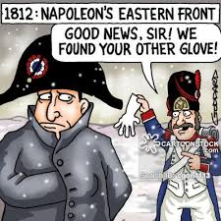

Slide 6
Some Examples
Lost earring
Puzzle pieces, game pieces
Gloves
Shoe
Power Cord
Pieces of a dish or silverware set
Components to fix appliances
Car parts

Slide 7
Technologies
Javascript
Jquery
MqSQL
NPM Modules:
Node
Express
Body-Parser

Slide 8
Demo

